Slide 1
Overview of the BioLUC Model
Daniel Inman, PhD
Biofuels Land Use Change Modeling Workshop
Oak Ridge National Laboratory
May 7th, 2013

Slide 2
Project Overview
Project came out of the Land Use Change and Bioenergy Workshop held May 11-14, 2009 in Vonore, TN.
Early collaborators: John Sheehan (UMN) and Nathaniel Greene (NRDC)
Initial project was folded in NREL’s “Strategic Analysis” task, FY 10.
Current team: Steve Peterson (Dartmouth College), Brian Bush (NREL), Laura Vimmerstedt (NREL), Ethan Warner (NREL), and Daniel Inman (NREL).

Slide 3
Milestones & Publications
FY | Quarter | Title
13 | Q4 | Release of the model to the community at-large through the Bioenergy KDF or equivalent outlet to-be-determined.
13 | Q4 | LUC modeling working meeting – NREL and ORNL will meet with a small group of key stakeholders involved with biomass program modeling of LUC to exercise the LUC models
13 | Q3 | Expansion of the model to include 18 global regions, plus the US – 19 total.
12 | Q4 | NREL will produce an updated land use change systems dynamics model with expanded regionality.
11 | Q4 | Report will summarize results of analysis conducted once BSM and LUC models are integrated. The combined model will more clearly demonstrate the effects of land use change on the expanding biofuels market.
Publications:
Warner, E., D. Inman, B. Kunstman, B. Bush, L. Vimmerstedt, S. Peterson, J. Macknick, and Y. Zhang. 2013. Modeling Biofuel Expansion Effects on Land Use Change Dynamics. Submitted to Environmental Research Letters (8)015003 (10pp). doi: 10.1088/1748-9326/8/1/015003.
Warner, E., D. Inman. 2013. Insight: how will biofuels change land use? Environmental research web. March 20, 2013. url: http://environmentalresearchweb.org/cws/article/news/52780
3
Notes:
All scheduled milestones have been completed on time.
All of the milestones completed have directly addressed specific MYPP goals:
St-B. Consistent, Defensible Message on Bioenergy Sustainability: The prevalence of misrepresentations of the effects of bioenergy – including assumptions, scenarios, and model projections that lack empirical underpinnings – creates confusion about the benefits of bioenergy production and leaves the industry vulnerable to criticism.
St-C. Sustainability Data across the Supply Chain: A fundamental hurdle is the lack of data to evaluate sustainability along the supply chain and to compare effects of one pathway with another. The lack of adequate and accessible temporal and spatial data for measuring sustainability hinders other critical activities such as establishing baselines, determining targets for improvement, recommending best practices, and evaluating tradeoffs.
St-F. Systems Approach to Bioenergy Sustainability: The sustainability of the entire supply chain is not considered in current assessments of technical feasibility and economic optimization. No tools exist to allow researchers to consider the potential interactions and trade-offs among different goals (energy security, biodiversity protection, low-cost commodities) and different bioenergy scenarios.

Slide 4
NREL’s modeling strategy & approach
System Dynamics Framework
Stocks/flows
Feedback within and across stages in supply chain
Modular, “Regional” model architecture
“Region” can reflect world, nation, geographical region, level of development, etc.
Enables rapid extension of model from 1 → 2 → n regions
Current structure includes US + 18 regions
Reliance on GDP/capita scenarios and FAO data to drive dynamics around population, yield, food demand.
Calibrate model against FAO datasets for land use and disposition.
Avoidance of explicit market mechanism

Slide 5
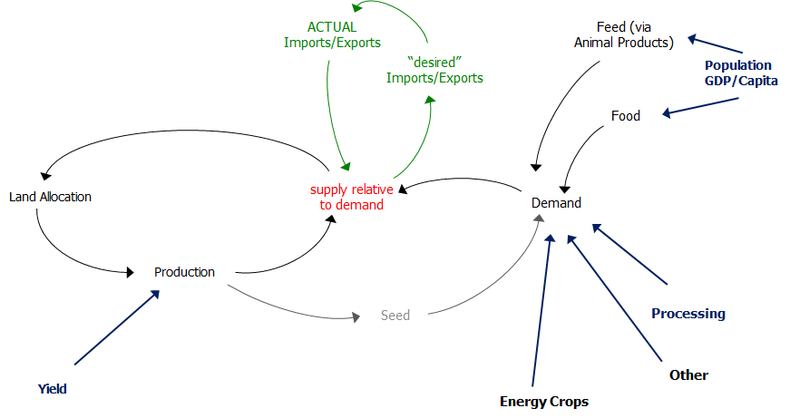
Our model captures important system interactions
Feed (via
Animal Products)
Notes:
structure and dynamics of global LUC align with key attributes of the SD toolset. One fundamental characteristic of LUC is the movement of land between usage categories (for example, abandonment of crop land) over time. In the SD model, stocks provide a mechanism for capturing the distribution of land in different classes at any point in time, while flows capture the movement of land between classes. A second characteristic of LUC relates to the mechanisms through which imbalances between production and consumption of various products from the land motivate changes in the allocation of lands among different uses. These are information feedback processes. A key feature of the NREL LUC model is its simple yet rich representation of key feedback processes that drive the allocation of land over time.

Slide 6
Land, crop, and animal classes are aggregated into larger categories
4 x 2 Land Bases
“Available” | Pasture | Cropland | Abandoned
Grassland | Forest
12 Cropland uses
Fallow
Forage
Fiber | Vegetable Fruit Nut | Other
Maize | Wheat | Rice | Grains NEC | Oil crops | Sugar
Energy Crops
Four Animal Product Categories
Cattle/Sheep/Goat | Dairy | Swine | Chicken
Induced demand from animal product to commodity crops, pasture, forage

Slide 7
Per-capita meat demand drives LUC
 | Base case system input per kg of product
Animal Class | Forage | Pasture | Maize | Wheat | Rice | NEC | Oil Crop | Sugar | Total kg
Cow Goat Sheep | 6.1 | 4.9 | 2.6 | 0.1 | 0.0 | 0.0 | 1.1 | 0.0 | 14.8
Dairy | 4.5 | 0.0 | 1.2 | 0.0 | 0.0 | 2.0 | 0.0 | 0.0 | 7.7
Pig | 0.0 | 0.0 | 1.2 | 1.4 | 0.0 | 0.3 | 0.7 | 0.0 | 3.6
Poultry | 0.0 | 0.0 | 1.4 | 0.3 | 0.0 | 0.0 | 0.6 | 0.0 | 2.4

Slide 8
Import/export structure seeks equilibrium
Basic Challenge: Provide simple mechanism for handling product movements across regional boundaries
Approach: View x-region product movements as equilibrium-seeking, but with a constraint
Supply/demand imbalance in one region drives “desire” for import/export
Total GLOBAL Imports must match total GLOBAL Export
Key insight: Global pressure (as reflected by difference in global desired import/export vs total ACTUAL import/export) translates into land use pressure.
Notes:
Avoidance of an explicit price mechanism. In market systems, price forms a feedback control mechanism that seeks to equilibrate production and consumption flows while sustaining product inventories at desired levels. Other things equal, when production is less than consumption, prices will increase. Similarly, when safety stocks of product are less than required, prices will tend to rise. The resultant price increases will stimulate production, depress consumption, and thus tend to drive the system toward equilibrium. We have chosen not to explicitly represent prices in the NREL LUC model. Instead, we have focused directly on the feedback mechanisms that equilibrate production, consumption, and inventories. When supply is out of balance with demand, the model uses the imbalance directly to motivate changes in land use, crop land allocation, and imports/exports. This allows us to capture in the model the result of the price control mechanism on the evolution of the system, without introducing the detail and dynamic complexities that come along with provision of a dynamic pricing mechanism for multiple crops and animal products in potentially multiple regions.

Slide 9
Our model is data-agnostic, but has been calibrated with FOA and WAO datasets
Most of the raw data comes from the FAO data sets.
The FAO data was processed (organized, normalized) to provide calibration data sets.
Regressions against GDP and other variables where used to develop forecasts of demands and yields.
Literature searches yielded information on land and crop inputs to livestock production, forage characteristics, and other incidental input parameters.

Slide 10
Scenario Conditions
Base Case
0.7% yield growth per year, 2010-2050
0.1% per capita commodity crop demand per year, 2010-2050
0.4% per capita meat and dairy demand per year, 2010-2050
4.3% increase in biofuel demand (MJ) per year, 2010 to ~2020
High Food and Fuel
0.7% yield growth per year, 2010-2050
0.4% per capita commodity crop demand per year, 2010-2050
0.7% per capita meat and dairy demand per year, 2010-2050
2.3% increase in biofuel demand (MJ) per year, 2010 to 2050
Low Yield
0% growth per year from 2013 to 2050
Otherwise, same as the base case

Slide 11
Scenario - Detailed Conditions
Globally in 2000
9 million ha harvested for biofuels
0.6 EJ biofuels
110-280 kg meat and dairy/capita-yr
260-300 kg other food/capita-yr
Base Case globally – by 2050
80 million ha harvested for biofuels
7 EJ biofuels
140-310 kg meat and dairy/capita-yr
280-290 kg other food/capita-yr
High Food and Fuel – by 2050
700 million ha harvested for biofuels
46 EJ biofuels
200-360 kg meat and dairy/capita-yr
330-340 kg other food/capita-yr

Slide 12
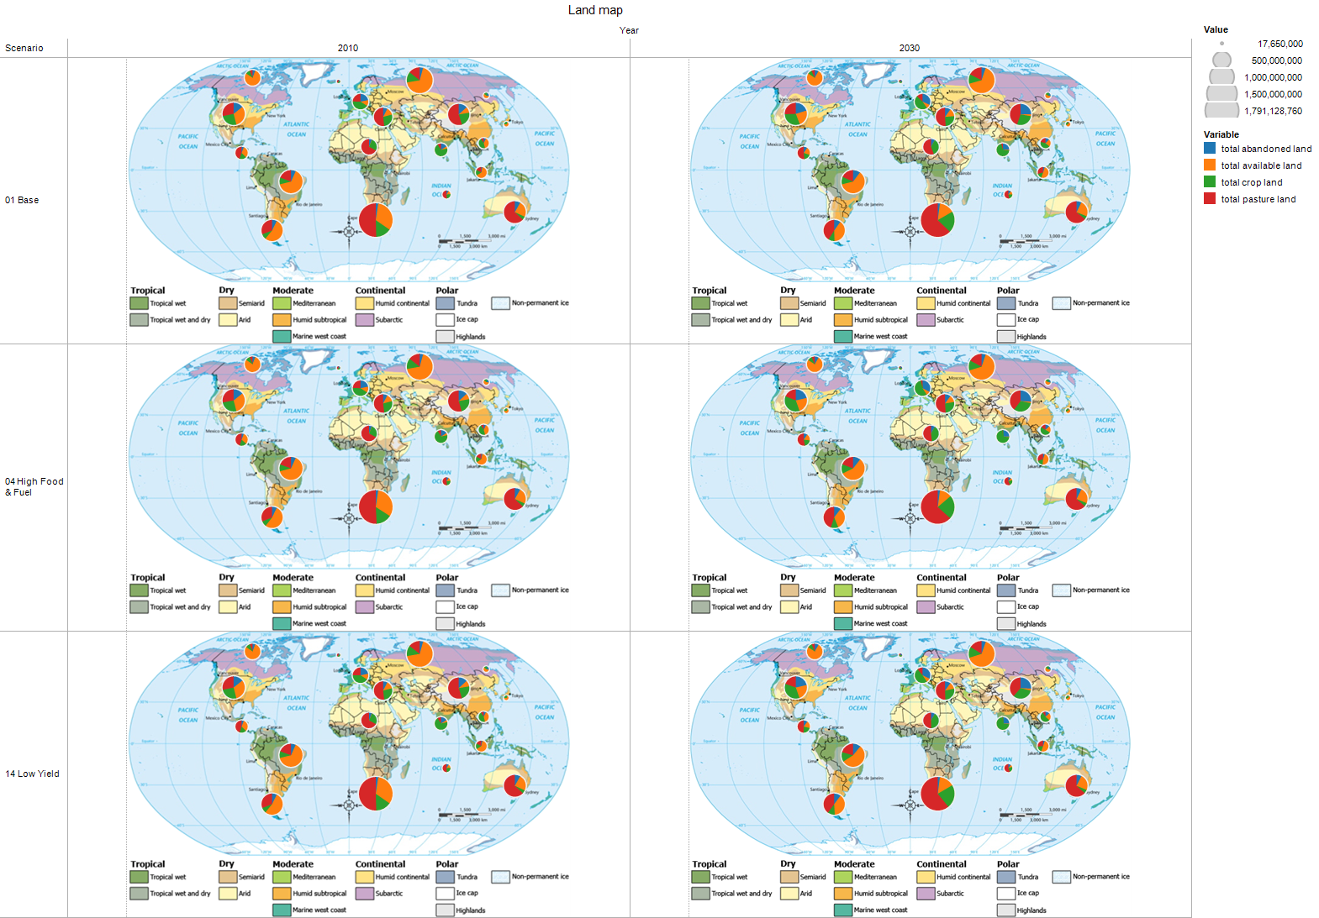
Sample results (more later…)
Notes:
Overall; the base case LUC changes are a result of continued trends in population and diet. In general, we see expansion of land dedicated to pasture- this is in response to increasing demands for meat based on dietary shifts.
In the high food and biofuel demand, we see a shift in cropland for the US and EU- cropland is being expanded to meet biofuel demands in those regions. Also, we see a marked shift to cropland expansion in Asia.
The low yield scenario appears very similar to the high biofuel/food scenario. Overall more land has to be converted to crops to meet the increaseind demand for food.

Slide 13
Relevance to BETO
BioLUC modeling effort is focused on improving our understanding of how bioenergy and LUC interact.
Once this project is complete, the model will be released publically along with the datasets that we have processed.
We expect the model to facilitate much discussion among stakeholder as well as provide an accessible medium upon which groups may test different assumptions and datasets.
Having a transparent and relatively simple (i.e., runs quickly, isn’t very large, etc.) will add tremendous value to the community as a whole.
It is our hope that the release of this model will stimulate an “open-source” level of interest and external development.
Notes:
Purpose: The objectives should describe what you are trying to do, both over the life of the project and since the last review.
Relevance to the Bioenergy Technologies Office includes contribution to achievement of specific targets and milestones as outlined in the MYPP and identified relevance to pathway(s). Also include relevance to the industry and the market place.

Slide 14
FY 13 Work Plan
The BioLUC project will wrap up by the end of FY13.
The goal of the remainder of the year is to prepare the model for release on the KDF .
 | April | May | June | July | Aug | Sept
Pre workshop testing | X
Workshop |  | X
Update based on workshop |  | X | X | X
Pre release testing |  |  | X
Release |  |  |  | X
Release support |  |  |  |  | X | X
The workshop at ORNL is a major milestone and decision point.
We incorporate suggestions/input from the workshop prior to public release.
Notes:
Purpose: Describe what will be done in the remainder of this year and in the coming year.

Slide 15
Current Scenario Extremes
Yields:
0 – 1.1% average growth
Population:
0.3 – 1.3% average growth
Per Capita Commodity Demand:
~ 0.1 – 0.4% average growth
Per Capita Meat and Dairy Demand:
~ 0.4 – 0.7% average growth
Biofuel Land Demand
0% to 4.3% average growth

Slide 16
Potential Directions for Hands on Exploration (chords/modes to riff on…)
Initial change drivers of LUC.
E.g., cultural, technical, political, economic
Extreme scenarios
Current extremes
New “model breaking” extremes
Changes in diet- preferences and substitutions…

